Slide 1
Constructors in Java
In Java, a constructor is a block of codes similar to the method. It is called when an instance of the class is created. At the time of calling constructor, memory for the object is allocated in the memory.
Every time an object is created using the new keyword, at least one constructor is called.
It calls a default constructor if there is no constructor available in the class. In such case, Java compiler provides a default constructor by default.
There are two types of constructors in Java: no-arg constructor, and parameterized constructor.
There are two rules defined for the constructor.
Constructor name must be the same as its class name
Constructor must have no explicit return type
Java constructor cannot be abstract, static, final, and synchronized
Copy Constructor

Slide 2
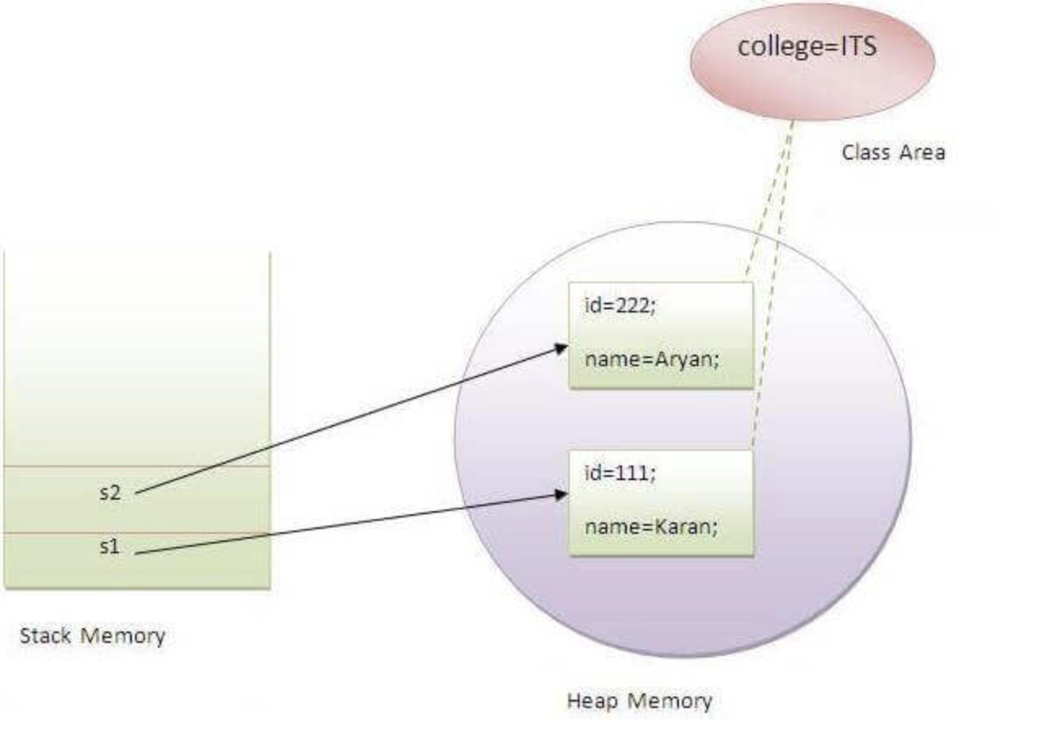
Java static keyword
The static keyword in Java is used for memory management mainly. We can apply static keyword with variables, methods, blocks and nested classes. The static keyword belongs to the class than an instance of the class.
The static can be:
Variable (also known as a class variable)
Method (also known as a class method)
Block
Nested class

Slide 3
There are two main restrictions for the static method. They are:
The static method can not use non static data member or call non-static method directly.
this and super cannot be used in static context.
We can create static variables at the class level only.
static block and static variables are executed in the order they are present in a program.
When to use static variables and methods?
Use the static variable for the property that is common to all objects. For example, in class Student, all students share the same college name. Use static methods for changing static variables.

Slide 4
this keyword in Java
Usage of java this keyword.
this can be used to refer current class instance variable.
this can be used to invoke current class method (implicitly)
this() can be used to invoke current class constructor.
this can be passed as an argument in the method call.
this can be passed as argument in the constructor call.
this can be used to return the current class instance from the method.

Slide 5
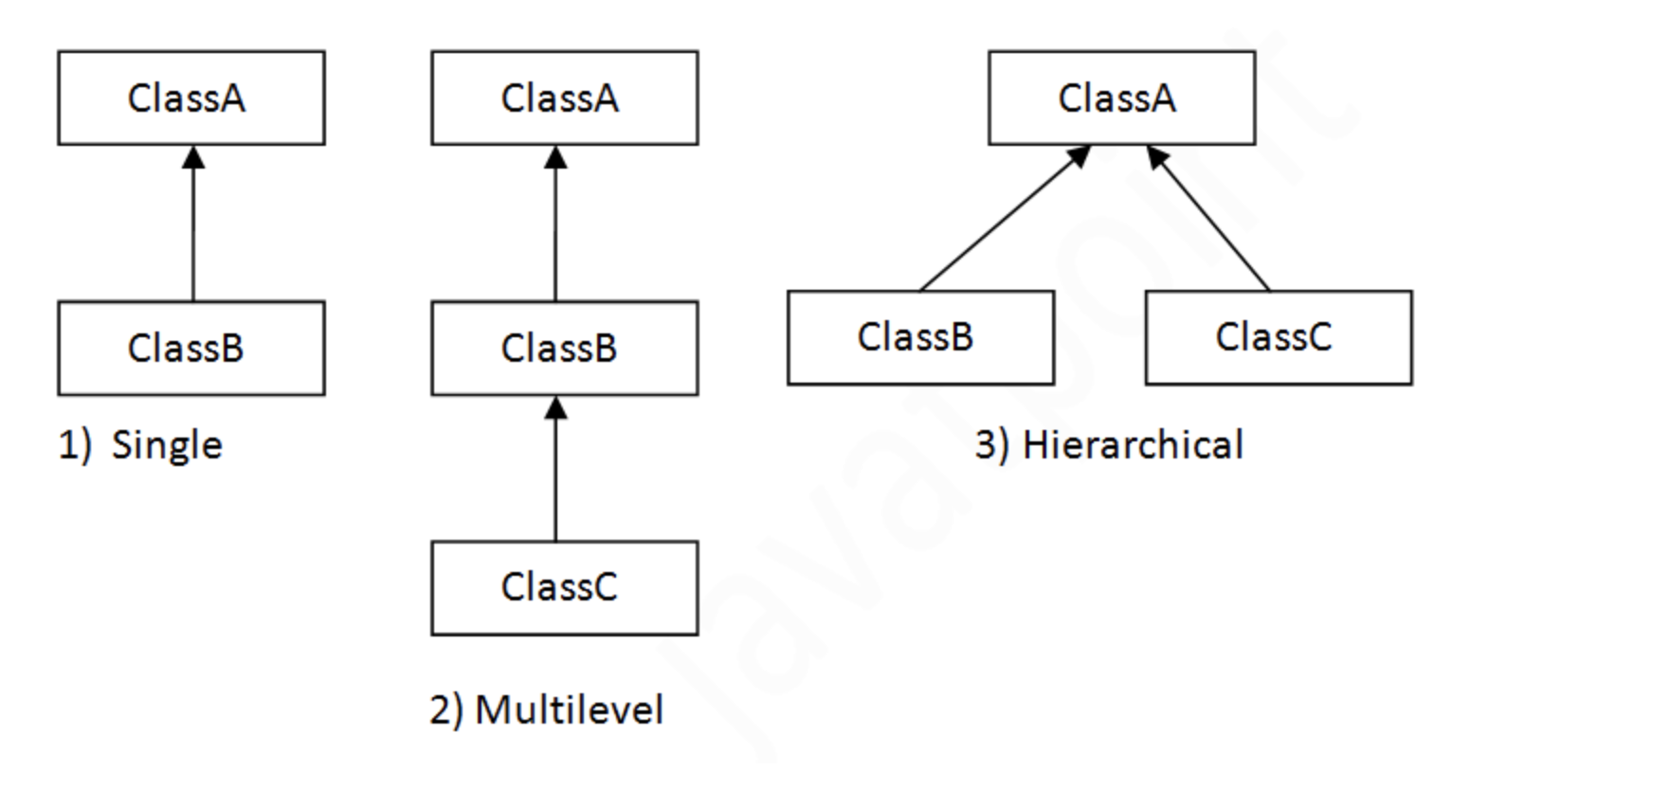
OOPS concepts()
Inheritance
Polymorphism
Abstraction
Encapsulation
Inheritance(extends)
Inheritance in Java is a mechanism in which one object acquires all the properties and behaviors of a parent object.
adv: Code Reusability.
disadv: Multiple inheritance not supported

Slide 6
Polymorphism
Method overloading
If a class has multiple methods having same name but different in parameters, it is known as Method Overloading.
There are two ways to overload the method in java
By changing number of arguments
By changing the data type
Method Overriding
If subclass (child class) has the same method as declared in the parent class, it is known as method overriding in Java.
Usage of Java Method Overriding
Method overriding is used to provide the specific implementation of a method which is already provided by its superclass.
Method overriding is used for runtime polymorphism
Rules for Java Method Overriding
The method must have the same name as in the parent class
The method must have the same parameter as in the parent class.

Slide 7
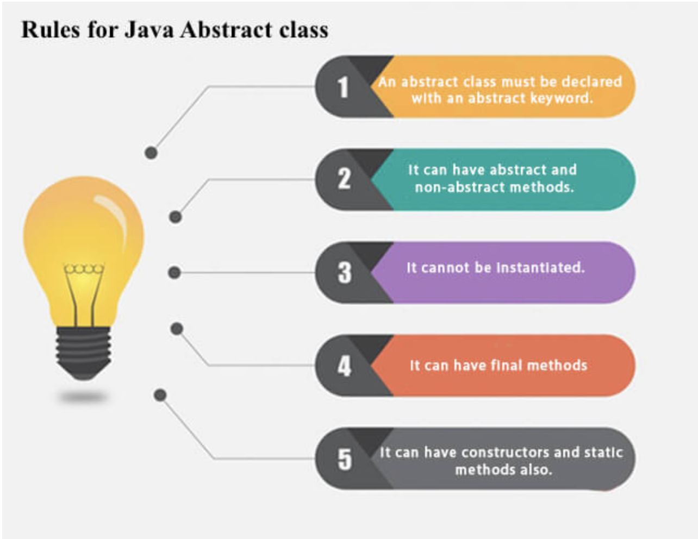
Abstraction in Java
Abstraction is a process of hiding the implementation details and showing only functionality to the user.
There are two ways to achieve abstraction in java
Abstract class (0 to 100%)
Interface (100%)
Abstract class in Java
A class which is declared as abstract is known as an abstract class. It can have abstract and non-abstract methods. It needs to be extended and its method implemented. It cannot be instantiated.
Boolean login(String username,String password);

Slide 8
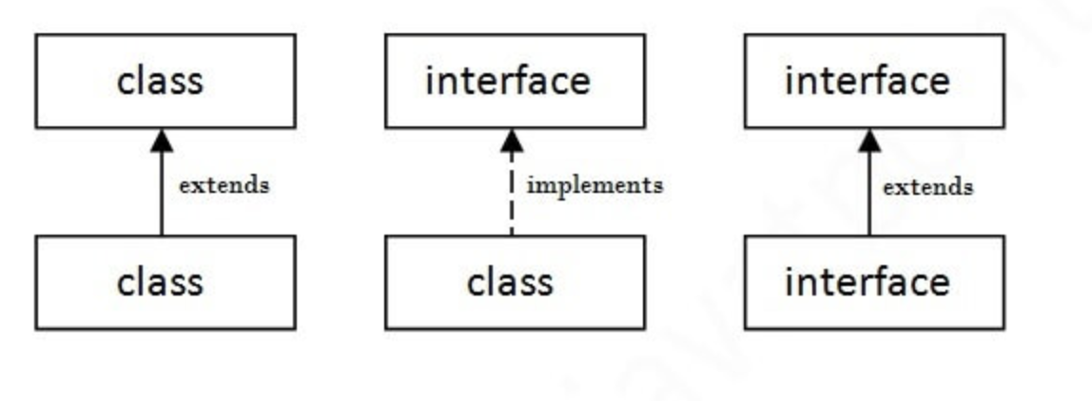
Interface in Java
An interface in Java is a blueprint of a class. It has static constants and abstract methods.
The interface in Java is a mechanism to achieve abstraction. There can be only abstract methods in the Java interface, not method body. It is used to achieve abstraction and multiple inheritance in Java.
It cannot be instantiated just like the abstract class.
Since Java 8, we can have default and static methods in an interface.
Since Java 9, we can have private methods in an interface.
Implements keyword is used
Multiple inheritance

Slide 9
Encapsulation in Java
Encapsulation in Java is a process of wrapping code and data together into a single unit.
Advantage of Encapsulation in Java
By providing only a setter or getter method, you can make the class read-only or write-only. In other words, you can skip the getter or setter methods.
It provides you the control over the data. Suppose you want to set the value of id which should be greater than 100 only, you can write the logic inside the setter method. You can write the logic not to store the negative numbers in the setter methods.
It is a way to achieve data hiding in Java because other class will not be able to access the data through the private data members.
The standard IDEs are providing the facility to generate the getters and setters. So, it is easy and fast to create an encapsulated class in Java.

